Slide 1
AI in Practice
Gabriel Gilling
Advisory AI Engineer, IBM Client Engineering

Slide 2
Overview of AI Use Cases in 2024
Most Generative AI applications revolve around using Foundation Models: models that are trained on a LOT of data, and often use deep Neural Networks to learn and reproduce patterns in the data
Different than what can be called the “machine learning” model, where the goal is to learn relationships in a dataset to model future outcomes
Today we’ll focus on text based Generative AI use cases
Non text-based foundation models can do music, image, movie, geospatial etc.
Differentiate between consumer applications (i.e. generating a fun poem) vs enterprise applications (modernizing a code base)
Both approaches are monetized very differently!
There can be substantial overlap between the categories, but enterprise applications are fundamentally interested in the bottom line (more productivity, lower costs)

Slide 3
Use cases
Retrieval Augmented Generation
Why is it needed, what it is
IES – Document based
PSU – Website based
CUNY?
Evaluating results, LLM as RAG
Evaluation during development
Real time evals if we have time
Consuming via assistants
Tweaking PSU assistant to customize answers based on where a student lives and what they study
Preventing hallucinations in real time (guardrails)
The future: agentic frameworks, function/tool calling, advanced RAG, fine tuning
Notes:
More than meets the eye: Architecture diagrams, connecting components

Slide 4
Enterprise Applications
Customer Facing AI
Virtual Assistants (chatbots)
Technical AI
Coding and App Modernization
AI / IT Operations
Industry AI
Healthcare, Finance, Retail etc.

Slide 5
Large Language Model Skills
What an LLM can do for you:
Summarization
Fact Extraction
Question Answering
Document Analysis
Content Generation
Text classification
Code Generation
Remember there can be substantial overlap between these skills!

Slide 6
Introduction to Retrieval Augmented Generation (RAG)
Prompt =
Instructions + Search Results + Question
Generated output with sources
User
Question
LLM
Top search results
Search & Retrieval
Similarity Search
Notes:
This slide highlights the typical process by which Retrieval Augmented Generation (RAG) is performed.
First, a user asks their question (or enters their request… this is all done via a prompt). This is passed along to the Search and Retrieval system. The top search results are retrieved then combined with some instructions and the user's original question to form the final prompt. The final prompt is then sent to the large language model (LLM), which generates a response (completion) that is passed back to the user.
This isn't a future use case; organizations are using this capability today. In a case of IBM "drinking their own champagne" using the RAG pattern, watsonx.ai is being used to answer user questions regarding its own product documentation. When watsonx.ai’s documentation is searched, an LLM generates a short answer to supplement the usual search results. It leverages the existing search functionality to find relevant topics in the documentation corpus (outside of the knowledge of the LLM) and then text from the top search results is combined with a question-answering prompt, which is sent to a model in watsonx.ai. Along with the generated answer, the system can provide a user with links to the source(s) of information passed along in the prompt.
The prompt below is similar to what IBM uses in this scenario. The documentation text returned from the search is placed into the "[ Topic text goes here ]" area, instructions to the model on how to generate the output are provided there, the user's original question is specified, and finally the model is prompted to generate an answer. The model is even instructed to return an answer of "I don't know" when a good answer can't be found, which should minimize the occurrences of hallucinations and inaccurate answers.
Article: ### [ Topic text goes here ] ### Answer the following question using only information from the article. Answer in a complete sentence, with proper capitalization and punctuation. If there is no good answer in the article, say "I don't know". Question: [ Customer question goes here ] Answer:
For more details on this watsonx.ai RAG use case, see: https://community.ibm.com/community/user/ai-datascience/blogs/sarah-packowski/2023/07/06/answering-watsonxai-questions.

Slide 7
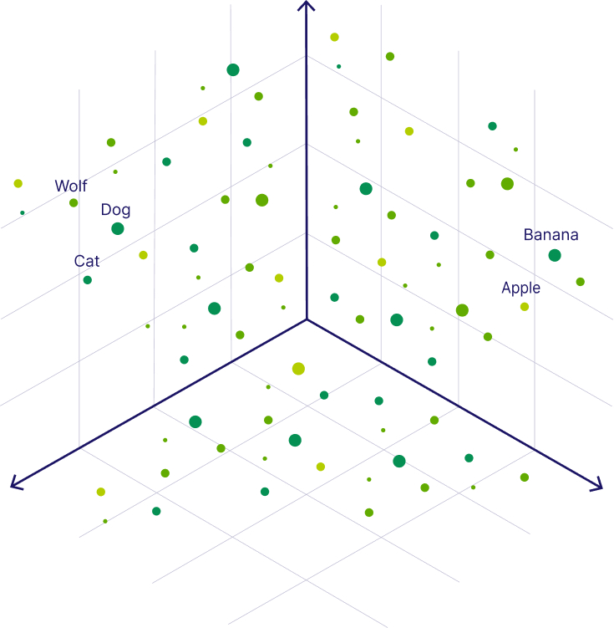
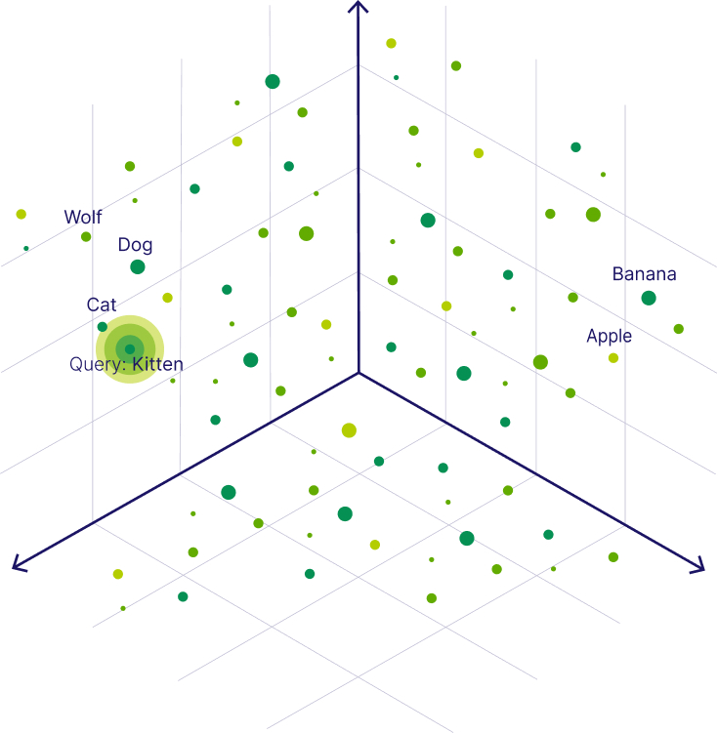
Similarity search
Example Word Vectors
Finding Similarities
What is "Kitten" similar to?
Common similarity measures: Cosine similarity, Euclidean distance, dot product
Source: https://weaviate.io/blog/what-is-a-vector-database
Notes:
As previously described, vector embedding is a long list of numbers, with each number representing a feature or attribute of a data object. Vector embeddings numerically capture the semantic meaning of objects in relation to other objects. Thus, similar objects are grouped together in the vector space, which means the "closer" (mathematically) two objects are in a high-dimensional space, the more similar they are.
In practice, embeddings contain tens, hundreds, or even thousands of numbers (they are used to describe the dimensions of the objects being represented), making it impossible to visualize. Rather than using a complicated high-dimensional example (which would be impossible to draw in any understandable way), the examples on this slide show 3-dimensional vector spaces. And rather than passages of text being represented, individual words are to keep this simple; however, the same concepts used for words apply to sentences). Each point on this slide represents a word and its vector location within the vector space. Note that the actual dimensions (numbers) are unknown in this example, but they have been generated such that fruits (banana and apple) are grouped/clustered together and animals (wolf, dog, and cat) are as well. "Dog" is close to "Wolf" (for obvious reasons) and "Dog" is closer to "Cat" than "Wolf" is to "Cat", possibly because dogs and cats are both pets. Perhaps one of the dimensions reflects whether the object is a living thing, and another dimension represents whether it's food. Again, this is simply a contrived example intended to explain the concepts involved.
Intuitively, it is obvious that a wolf is similar to a dog, but it is not similar to a banana. To perform this kind of comparison more generally with high-dimensional vector embeddings, vector databases employ algorithms to find similarities between objects. Common similarity measures include cosine similarity, and Euclidean distance, among others.
A query to a vector database may ask it to find objects similar to an input object. In this example, a query might ask what a "Kitten" is most similar to. The vector database returns "Cat", as they are very alike. It may also return "Dog", depending on the search aperture (for example, if it the query was centered around pets).
In a Retrieval Augmentation Generation (RAG) use case, what gets stored in the vector database are embeddings of sentences, paragraphs, or small documents. When a user asks a Large Language Model (LLM) question or makes a request, it is fed into the embedding model to create a vector embedding representing that input (using the same model used to enter the document embeddings into the vector database in the first place). The vector database is then queried to find embeddings similar to it, and the corresponding document(s) are retrieved and passed back to the caller, which then gets added to the prompt, and the LLM goes on to form the completion (final answer).
A complication of natural language understanding (NLU) is the fact that some words have multiple meanings. For example, "bark" might refer to the wrapping around a tree trunk, or it might refer to the noise a dog makes. LLMs are based on a transformer architecture, which understands context and word positioning (that is why they are so critical to this new generative phase of AI). Embeddings created by these models have dimensions that can reflect the context and semantic meaning of the input text. This means that a semantic search can easily differentiate between the phrases "the bark was peeling off of the tree" and "my dog likes to bark at delivery people".
Source of diagrams: https://weaviate.io/blog/what-is-a-vector-database

Slide 8
RAG in Practice – University Use Case
Mission:
Enhance student understanding and access to university resources by building a virtual agent that answers questions related to their experience and summarizes available resources
Curate a list of resources to answer student questions, with an emphasis on Diversity, Equity, Inclusion, and Belonging (DEIB)
Technical Objectives:
Ingest publicly available university data such as webpages, FAQs and resource lists into the platform
Leverage a Large Language Model (LLM) to process documents and answer questions about them
Embed the LLM into a virtual assistant

Slide 9
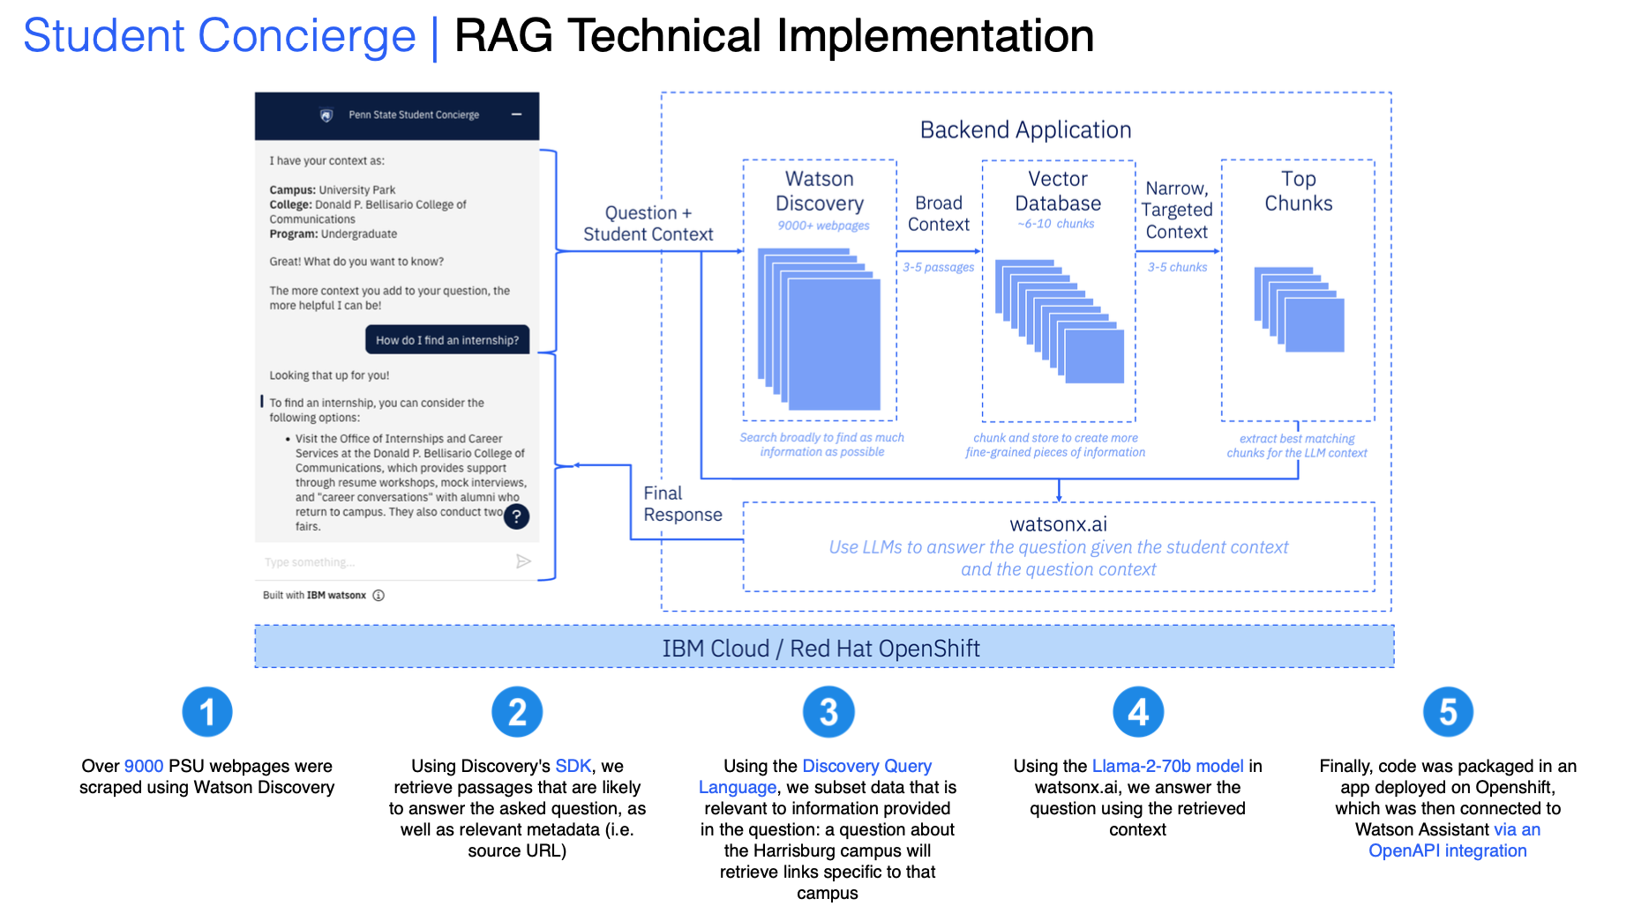
Notes:
More than meets the eye: Architecture diagrams, connecting components

Slide 10
Generation in Practice – (Another) University Use Case
Mission:
University Small to Medium Businesses (SMBs) do not have fully developed Job Postings
Career Office seeks to assist students find jobs and internships but
Forms created to help SMB create Job Postings, but...
Employers do not always complete forms,
Completed forms can be of varying quality (incomplete, inaccurate)
Office of Careers must reach out to employers to gather additional information to create a Job Posting
This can take up to two weeks
Office isn't able to prioritize increasing pipeline and relationships
Technical Objectives:
Demonstrate the power of watsonx.ai in processing job posting data to create consistent, high-quality job listings that enhance employers' success in filling positions, while effectively showcasing opportunities to CUNY talent.
Integrate watsonx.ai with IBM Carbon to develop an intuitive interface that empowers employers to generate job postings tailored to attract the right candidates.

Slide 11
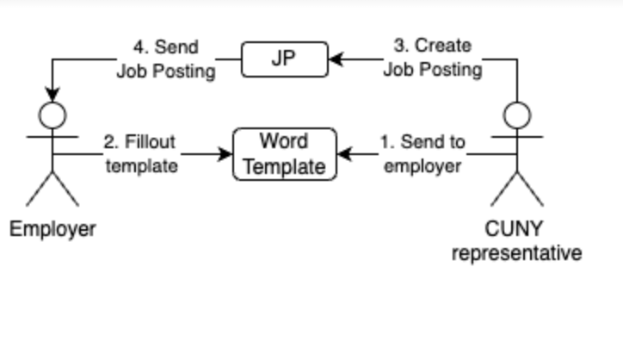
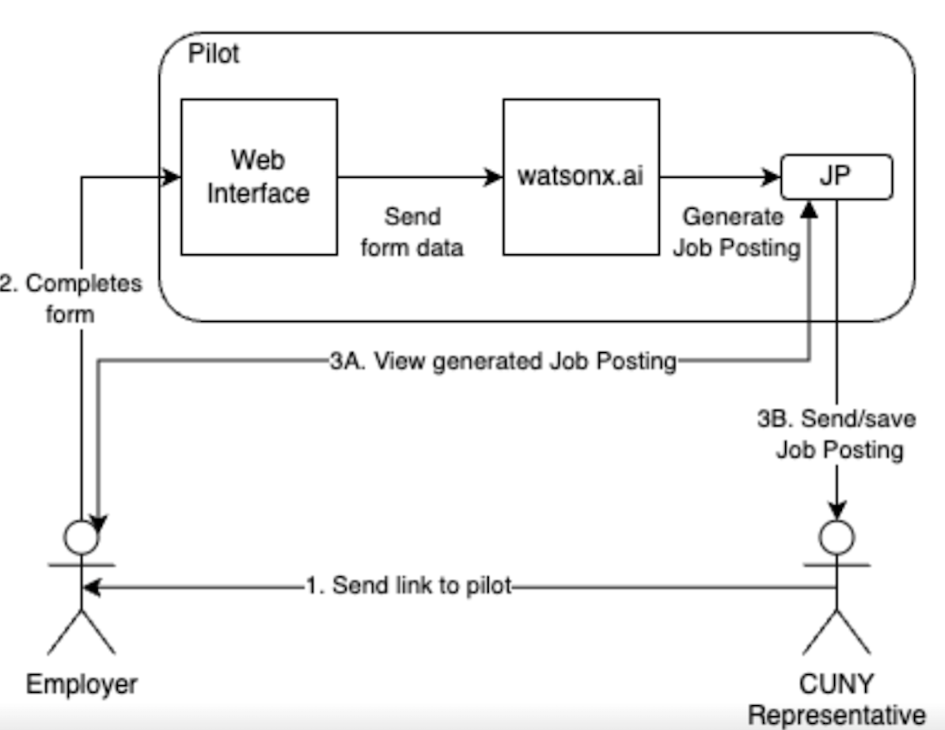
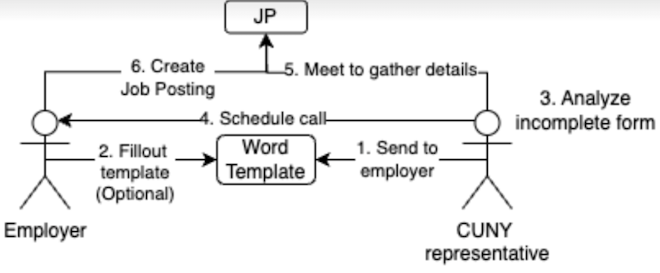
Employer Job Description Work Flow (As-Is & To-Be)
JP = Job Posting
JP = Job Posting
Current As-Is
To-Be Process
Ideal
Not ideal

Slide 12
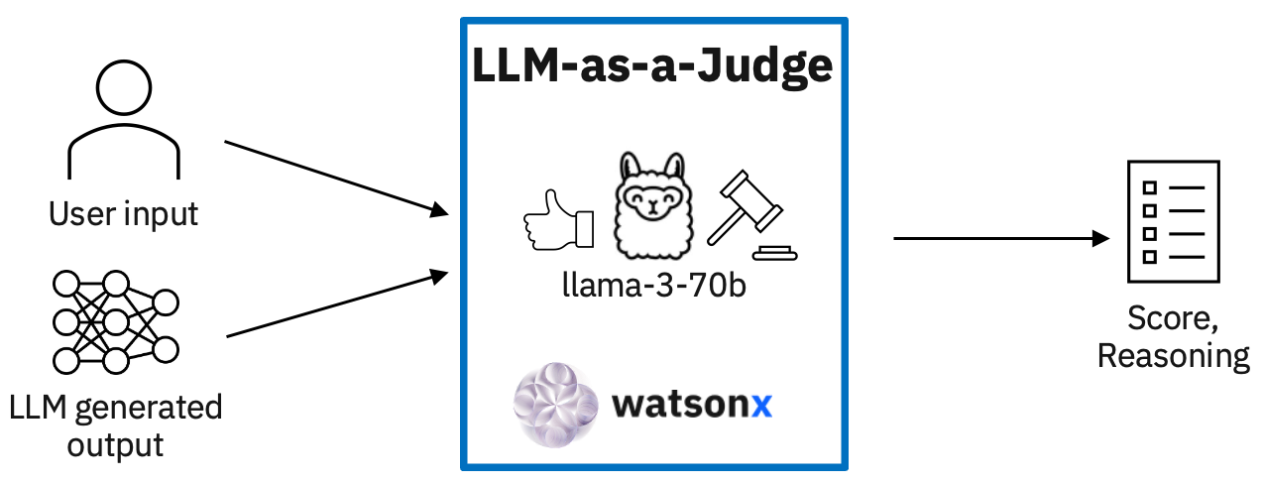
Evaluating LLM Results – LLM as Judge

Slide 13
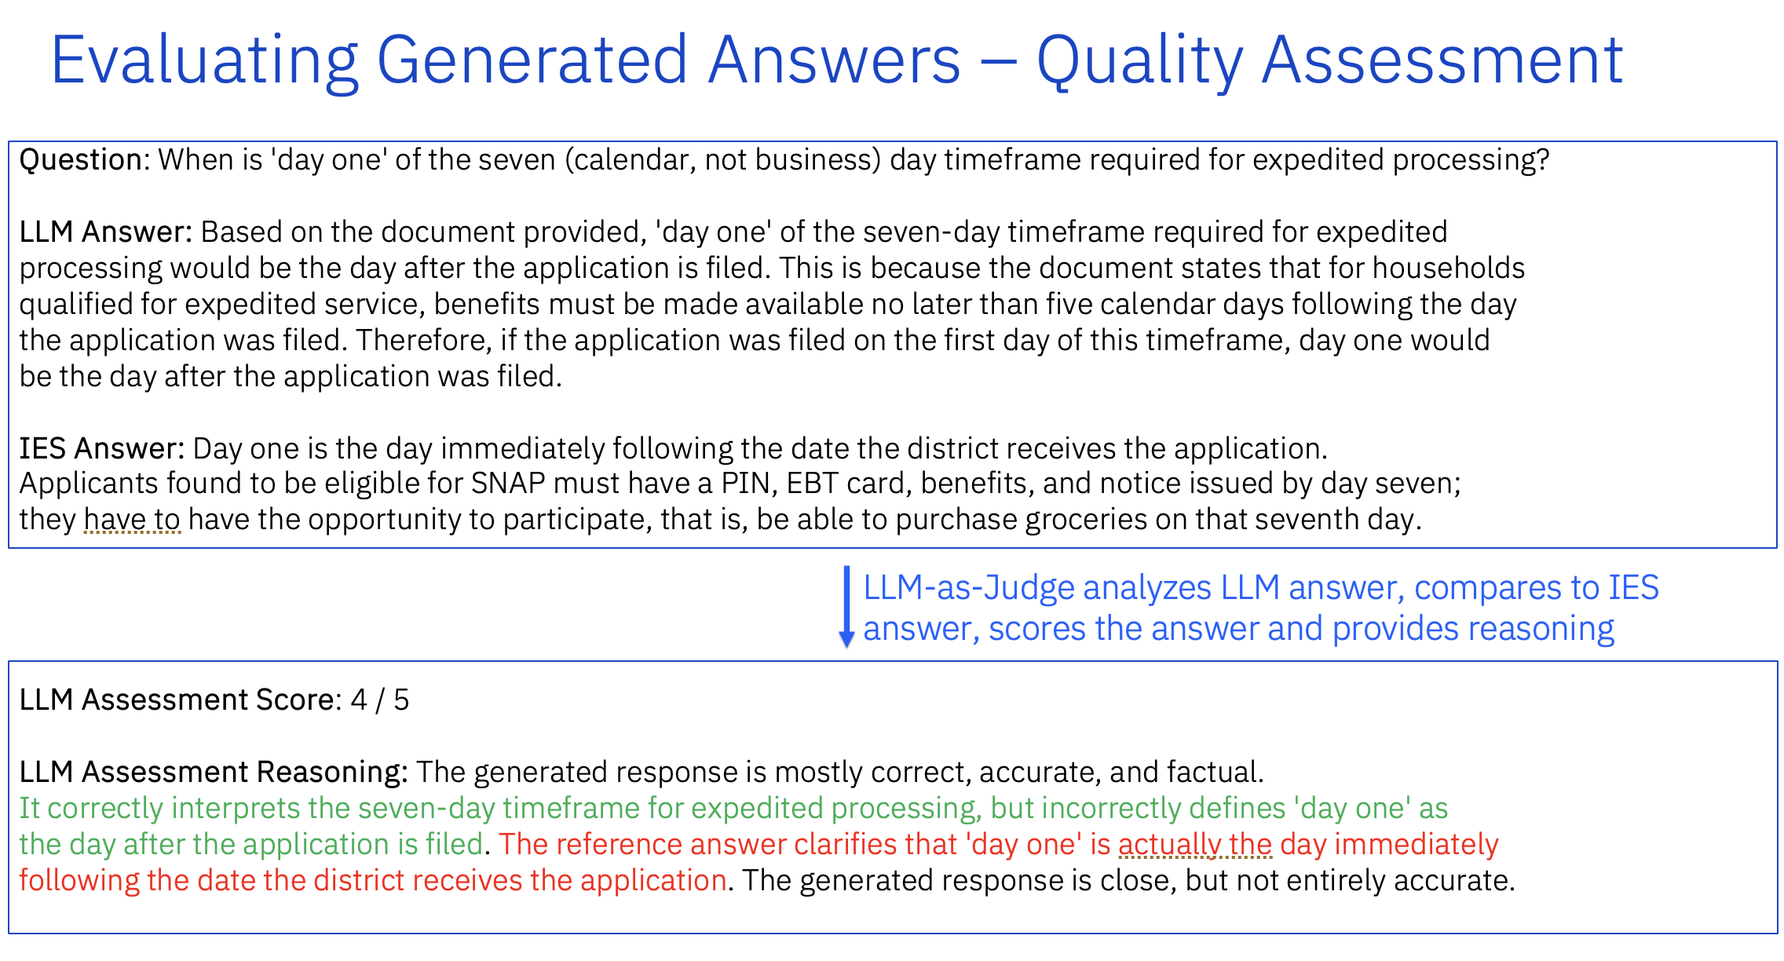

Slide 14
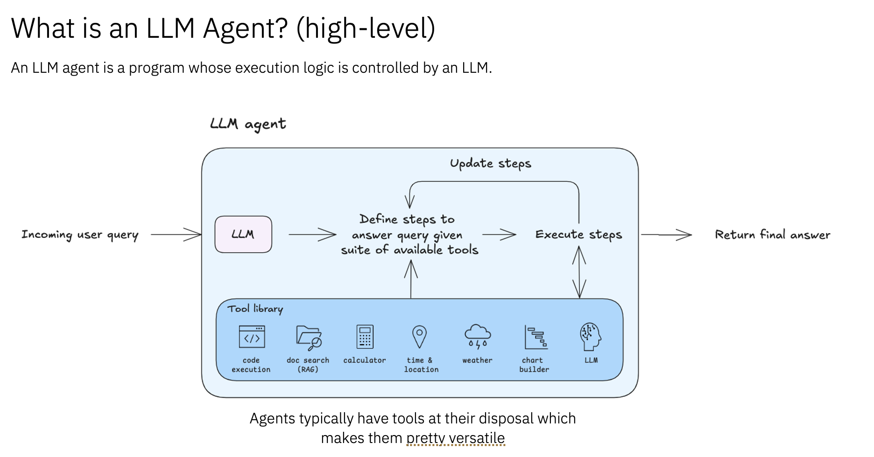
The Future – Agent Frameworks

Slide 15
Q&A

